Slide 1


Feature Engineering and Ensembles
15
PART III · MACHINE LEARNING CORE
CHAPTER 15 · WEEK 9
Data Science — From Foundations to Intelligent Systems
LECTURER
Dr. Mustafa Hameed
THE ISLAMIA UNIVERSITY OF BAHAWALPUR
Bahawalpur, Pakistan
Department of Information Technology · BSIT · Fall 2026
Notes:
Chapter 15: Feature Engineering and Ensembles. Part 3 — Machine Learning Core. Week 9: Features and ensembles; unsupervised (mostly revision). Handout pages 95–100.

Slide 2

Where this chapter sits
THE COURSE
PART I
PART II
PART III
PART IV
PART V
PART VI
1
2
3
4
5
6
7
8
9
10
11
12
13
14
15
16
17
18
19
20
21
22
23
24
25
26
27
28
29
30
31
32
Feature Engineering and Ensembles
BUILDS ON
USED LATER IN
Ch 13 Supervised Learning II: Classification
Ch 19 Sequences, Time Series and Streaming Analytics
Ch 14 Model Evaluation and Selection
Ch 25 Data Science for the Internet of Things
Data Science · Chapter 15 · Feature Engineering and Ensembles
Handout p. 95 2
Notes:
Place the chapter. Before you start: Chapter 13 (decision trees — the base learner for every ensemble here) and Chapter 14 (you must be able to measure before you can improve). Revision note: the ensembles half revises Machine Learning Fall 2026, Chapter 14 (Ensemble Learning); feature engineering is genuinely new.

Slide 3

What you will be able to do
LEARNING OUTCOMES
By the end of this chapter you will be able to:
1
Construct informative features from raw columns using ratios, aggregations, time deltas and domain knowledge.
2
Apply filter, wrapper and embedded methods of feature selection.
3
Explain how bagging reduces variance and boosting reduces bias.
4
Distinguish random forests from gradient boosting and choose between them.
5
Interpret feature importances, and state the traps in doing so.
Data Science · Chapter 15 · Feature Engineering and Ensembles
Handout p. 95 3
Notes:
Read these out: they are the chapter's contract with the room. Each click adds one.

Slide 4

Vocabulary for this chapter
KEY TERMS
feature engineering
feature selection
filter / wrapper / embedded methods
curse of dimensionality
ensemble
bagging
bootstrap
random forest
boosting
gradient boosting
stacking
feature importance
permutation importance
Each term is defined where it first matters — not here.
Data Science · Chapter 15 · Feature Engineering and Ensembles
Handout p. 95 4
Notes:
Do not define these now; they arrive one at a time. This slide is for the students' notes. Terms: feature engineering; feature selection; filter / wrapper / embedded methods; curse of dimensionality; ensemble; bagging; bootstrap; random forest; boosting; gradient boosting; stacking; feature importance; permutation importance.

Slide 5

In this chapter
IN THIS CHAPTER
15.1
Features Beat Algorithms
p. 95 ›
15.2
Feature Selection
p. 96 ›
15.3
Ensembles: Many Weak Models Beat One Strong One
p. 97 ›
15.4
Reading Feature Importances — Carefully
p. 98 ›
Data Science · Chapter 15 · Feature Engineering and Ensembles
Handout pp. 95–100 5
Notes:
The route through the chapter. Each row is a link: click it to jump to that section in the slide show.

Slide 6
Features Beat Algorithms
SECTION 1 OF 4
15.1
15.1 Features Beat Algorithms
15.2 Feature Selection
15.3 Ensembles: Many Weak Models Beat One Strong One
15.4 Reading Feature Importances — Carefully
Data Science · Chapter 15
Handout §15.1 6
Notes:
Pause. Name the question this section answers.

Slide 7

The Most Reliable Lesson in Applied Machine Learning
CONCEPT
Given a fixed dataset, moving from logistic regression to a tuned gradient boosting machine might buy you two or three points of performance. Adding one good feature that encodes something a domain expert knows can buy you twenty. Spend your time accordingly.
Data Science · Chapter 15 · Feature Engineering and Ensembles
§15.1 · Handout p. 95 7
Notes:
Read the box aloud, then ask for an example from the room before moving on.

Slide 8

Features Beat Algorithms
AT A GLANCE
Technique | Construction | Example
Ratios | Divide one column by another | submissions / days_enrolled normalises for late joiners
Differences & deltas | Subtract, or compare with a previous row | this_week_logins − last_week_logins captures change, which raw counts hide
Aggregations | Group and summarise | mean, max and standard deviation of a sensor over a 1-hour window
Time features | Extract components | hour of day, day of week, is_weekend — crucial in security and IoT
Counts of rare events | Count occurrences in a window | failed logins in the last 5 minutes
Binning | Convert numeric to ordinal | attendance into {low, medium, high} for a readable rule
Interactions | Multiply two features | low_attendance × first_generation
Domain flags | Encode expert rules | missed_two_consecutive_labs
Data Science · Chapter 15 · Feature Engineering and Ensembles
§15.1 · Handout p. 95 8
Notes:
Do not read the table row by row: pick the row the room is most likely to get wrong and ask why.

Slide 9

Turning Raw Logs into Features
WORKED EXAMPLE
You have one row per VLE click: (student, timestamp, resource). A model needs one row per student, using weeks 1–4 only.
Volume: n_clicks, n_distinct_resources, n_active_days.
Recency: days_since_last_click. Frequently the single strongest predictor of disengagement — and note it is unobtainable from any aggregate count.
Trend: clicks_wk4 − clicks_wk1, and the slope of a line fitted through the four weekly totals. A student at 200 clicks and falling is in more danger than one at 80 and steady, yet both have similar totals.
Rhythm: share_of_clicks_after_midnight, n_weekend_days_active. Behavioural signatures, not effort measures.
Consistency: standard deviation of daily clicks. Steady beats bursty.
From three raw columns, twelve features — and the ones most likely to matter (recency, trend, consistency) do not appear in the raw data at all. This is what feature engineering is. Everything here uses only weeks 1–4, so framing question 4 (Chapter 2) is satisfied by construction.
Data Science · Chapter 15 · Feature Engineering and Ensembles
§15.1 · Handout p. 95 9
Notes:
Each click adds one step of the working. Ask for the next number before you reveal it.

Slide 10
Feature Selection
SECTION 2 OF 4
15.2
15.1 Features Beat Algorithms
15.2 Feature Selection
15.3 Ensembles: Many Weak Models Beat One Strong One
15.4 Reading Feature Importances — Carefully
Data Science · Chapter 15
Handout §15.2 10
Notes:
Pause. Name the question this section answers.

Slide 11

The Curse of Dimensionality
WATCH OUT
As the number of features grows, the volume of the feature space explodes and your data becomes sparse within it — every point ends up roughly equidistant from every other, which destroys distance-based methods. More features is not more information; past a point it is more noise.
Data Science · Chapter 15 · Feature Engineering and Ensembles
§15.2 · Handout p. 96 11
Notes:
Read the box aloud, then ask for an example from the room before moving on.

Slide 12
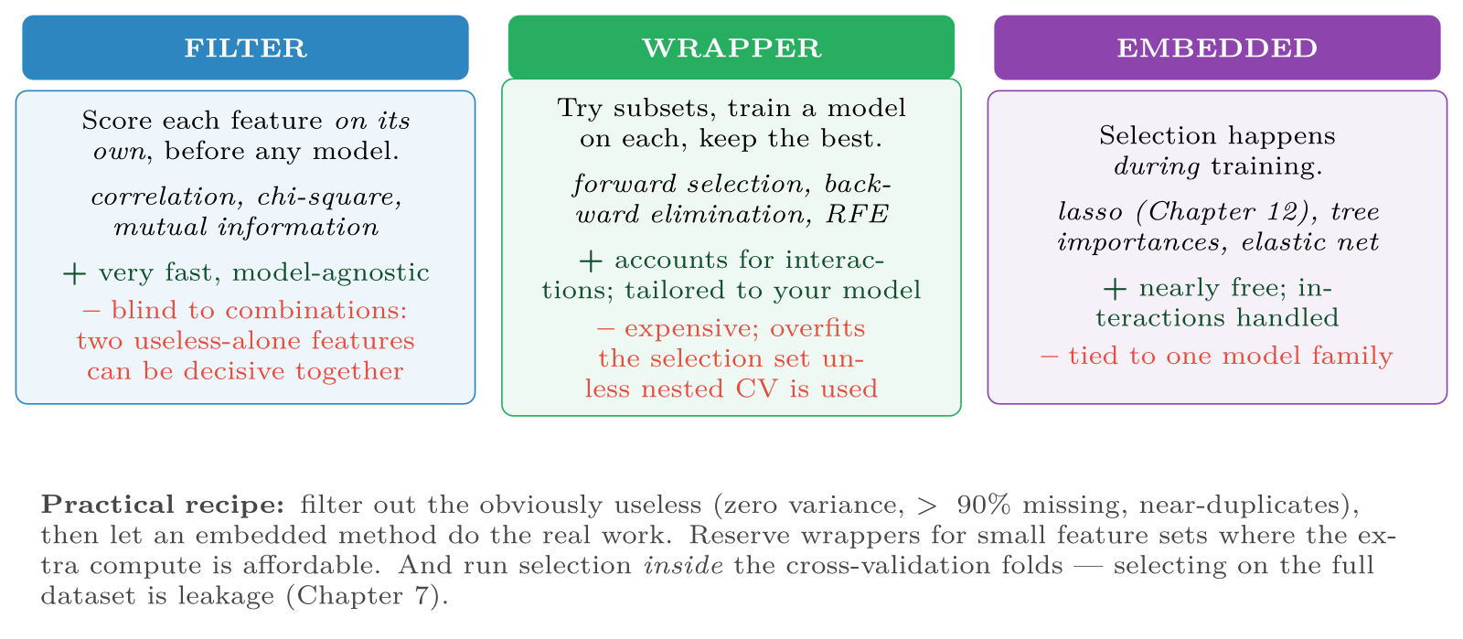
Three families of feature selection
FIGURE 15.1
The choice is mostly a compute-versus-quality trade-off, but the leakage warning applies to all three equally.
Data Science · Chapter 15 · Feature Engineering and Ensembles
§15.2 · Handout p. 96 12
Notes:
Figure 15.1 (handout p. 97): Three families of feature selection. The choice is mostly a compute-versus-quality trade-off, but the leakage warning applies to all three equally.

Slide 13
Ensembles: Many Weak Models Beat One Strong One
SECTION 3 OF 4
15.3
15.1 Features Beat Algorithms
15.2 Feature Selection
15.3 Ensembles: Many Weak Models Beat One Strong One
15.4 Reading Feature Importances — Carefully
Data Science · Chapter 15
Handout §15.3 13
Notes:
Pause. Name the question this section answers.

Slide 14

Ensemble
DEFINITION
A model made of many models. Predictions are combined — by voting for classification, averaging for regression. Ensembles work because individual models make different mistakes, and averaging cancels the uncorrelated part of the error.
Data Science · Chapter 15 · Feature Engineering and Ensembles
§15.3 · Handout p. 97 14
Notes:
Read the box aloud, then ask for an example from the room before moving on.

Slide 15
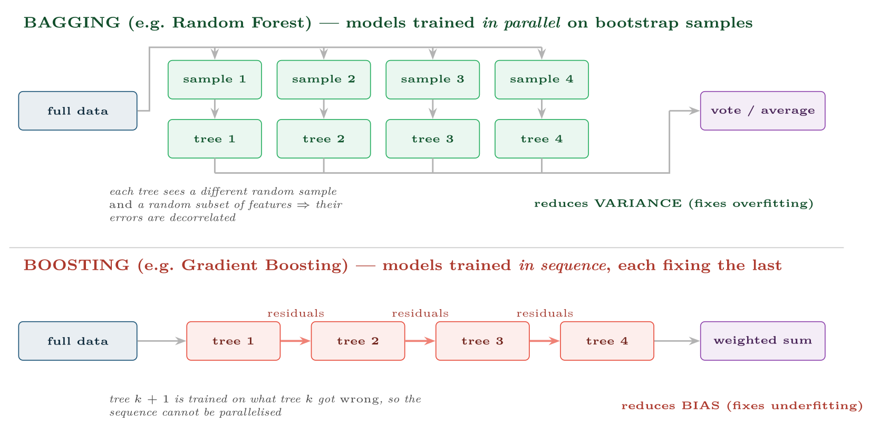
Bagging versus boosting
FIGURE 15.2
Bagging builds independent models and averages away their variance; boosting builds dependent models, each correcting its predecessor, and drives down bias. This is the distinction to remember.
Data Science · Chapter 15 · Feature Engineering and Ensembles
§15.3 · Handout p. 97 15
Notes:
Figure 15.2 (handout p. 97): Bagging versus boosting. Bagging builds independent models and averages away their variance; boosting builds dependent models, each correcting its predecessor, and drives down bias. This is the distinction to remember.

Slide 16
Random Forest
DEFINITION
Bagging applied to decision trees, with one addition: at each split, only a random subset of features may be considered. Without that, every tree would pick the same dominant feature first and the trees would be near-identical — defeating the whole purpose.
Data Science · Chapter 15 · Feature Engineering and Ensembles
§15.3.1 · Handout p. 97 16
Notes:
Read the box aloud, then ask for an example from the room before moving on.

Slide 17
Gradient Boosting
DEFINITION
Fit a weak model. Compute its residuals. Fit the next weak model to those residuals. Add it to the ensemble, scaled by a learning rate. Repeat. Implementations you will meet: XGBoost, LightGBM, CatBoost.
Data Science · Chapter 15 · Feature Engineering and Ensembles
§15.3.2 · Handout p. 98 17
Notes:
Read the box aloud, then ask for an example from the room before moving on.

Slide 18
Gradient Boosting
AT A GLANCE
 | Random Forest | Gradient Boosting
Training | Parallel — fast on many cores | Sequential — slower
Tuning | Forgiving; defaults usually fine | Sensitive; needs learning rate, depth, n trees
Overfitting | Resistant; more trees never hurts | Will overfit if over-trained; needs early stopping
Typical accuracy | Very good | Usually the best on tabular data
Choose it when | You want a strong result with little effort | You need maximum accuracy and can afford tuning
Data Science · Chapter 15 · Feature Engineering and Ensembles
§15.3.2 · Handout p. 98 18
Notes:
Do not read the table row by row: pick the row the room is most likely to get wrong and ask why.

Slide 19
The Honest Default for Tabular Data
CONCEPT
Start with a random forest. It is hard to misuse, needs no scaling, handles mixed types, and gives a strong number in one line. If that number is close enough to your success criterion, stop. Move to gradient boosting only when the remaining gap matters and you have the time to tune it properly.
Data Science · Chapter 15 · Feature Engineering and Ensembles
§15.3.2 · Handout p. 98 19
Notes:
Read the box aloud, then ask for an example from the room before moving on.

Slide 20
Three Traps in Feature Importance
WATCH OUT
• Correlated features split their importance. If attendance and lectures-watched correlate at 0.94, each may show half the importance it deserves, making both look unimportant.
• Impurity-based importance is biased towards high-cardinality features. A near-unique ID column can appear highly “important”.
• Importance is not causation. A feature can be important to the model because it is a proxy for something you must not act on (Chapter 28).
Prefer permutation importance: shuffle one column and measure how much performance drops. It is slower, model-agnostic, and measures what you actually mean by “does this feature matter”.
Data Science · Chapter 15 · Feature Engineering and Ensembles
§15.4 · Handout p. 98 20
Notes:
Read the box aloud, then ask for an example from the room before moving on.

Slide 21





Four lenses: Engineering Features
FOUR LENSES
LEARNING ANALYTICS
PROJECT MANAGEMENT
The highest-value features are almost never raw counts.
With 40 sprints, ensembles will overfit spectacularly.
INTERNET OF THINGS
CYBERSECURITY
Raw sensor values are weak; window statistics are strong.
Aggregate over time and entity: failed logins per account in 5 minutes, distinct destination ports per source in 1 minute, bytes-out to bytes-in ratio, deviation from that account’s own 30-day baseline.
Data Science · Chapter 15 · Feature Engineering and Ensembles
Handout p. 100 21
Notes:
The same method, four domains. Each of the next four slides opens one lens in full.

Slide 22

Learning Analytics: Engineering Features
FOUR LENSES
LEARNING ANALYTICS
Project Management
The highest-value features are almost never raw counts. Build days_since_last_activity, the slope of weekly engagement, and consecutive_missed_labs. A student’s trajectory carries far more signal than their total. Use a random forest for accuracy, but keep a depth-3 tree beside it as the explanation you can defend to an appeals panel.
Internet of Things
Cybersecurity
Data Science · Chapter 15 · Feature Engineering and Ensembles
Handout p. 100 22
Notes:
Learning Analytics. The highest-value features are almost never raw counts. Build days_since_last_activity, the slope of weekly engagement, and consecutive_missed_labs. A student’s trajectory carries far more signal than their total. Use a random forest for accuracy, but keep a depth-3 tree beside it as the explanation you can defend to an appeals panel.

Slide 23

Project Management: Engineering Features
FOUR LENSES
PROJECT MANAGEMENT
Learning Analytics
With 40 sprints, ensembles will overfit spectacularly. Engineer two or three strong features instead — points_committed / historical_velocity, share_of_tasks_with_unresolved_dependencies, team_changed_since_last_sprint — and fit something simple. This is a domain where feature engineering does not merely beat algorithm choice; it is the only thing that works.
Internet of Things
Cybersecurity
Data Science · Chapter 15 · Feature Engineering and Ensembles
Handout p. 100 23
Notes:
Project Management. With 40 sprints, ensembles will overfit spectacularly. Engineer two or three strong features instead — points_committed / historical_velocity, share_of_tasks_with_unresolved_dependencies, team_changed_since_last_sprint — and fit something simple. This is a domain where feature engineering does not merely beat algorithm choice; it is the only thing that works.

Slide 24

Internet of Things: Engineering Features
FOUR LENSES
INTERNET OF THINGS
Learning Analytics
Raw sensor values are weak; window statistics are strong. Compute rolling mean, standard deviation, min, max, and rate of change over 1-minute, 1-hour and 24-hour windows, plus frequency-domain features for vibration. This single step usually matters more than anything in Chapter 18. Gradient boosting on well-engineered window features is the standard, hard-to-beat baseline for predictive maintenance.
Project Management
Cybersecurity
Data Science · Chapter 15 · Feature Engineering and Ensembles
Handout p. 100 24
Notes:
Internet of Things. Raw sensor values are weak; window statistics are strong. Compute rolling mean, standard deviation, min, max, and rate of change over 1-minute, 1-hour and 24-hour windows, plus frequency-domain features for vibration. This single step usually matters more than anything in Chapter 18. Gradient boosting on well-engineered window features is the standard, hard-to-beat baseline for predictive maintenance.

Slide 25

Cybersecurity: Engineering Features
FOUR LENSES
CYBERSECURITY
Learning Analytics
Aggregate over time and entity: failed logins per account in 5 minutes, distinct destination ports per source in 1 minute, bytes-out to bytes-in ratio, deviation from that account’s own 30-day baseline. The last is the key idea — features relative to an entity’s own history detect compromise far better than absolute thresholds. Tree ensembles dominate here, but keep in mind that an adversary who learns which features you use will manipulate them (Chapter 26).
Project Management
Internet of Things
Data Science · Chapter 15 · Feature Engineering and Ensembles
Handout p. 100 25
Notes:
Cybersecurity. Aggregate over time and entity: failed logins per account in 5 minutes, distinct destination ports per source in 1 minute, bytes-out to bytes-in ratio, deviation from that account’s own 30-day baseline. The last is the key idea — features relative to an entity’s own history detect compromise far better than absolute thresholds. Tree ensembles dominate here, but keep in mind that an adversary who learns which features you use will manipulate them (Chapter 26).

Slide 26

Try it yourself: Engineer, Ensemble, Interpret
TRY IT YOURSELF
WHAT YOU WILL DO
1. Engineer from raw click logs
2. Ensembles
3. Interpret: permutation, NOT the built-in impurity importance
THIS WEEK'S LAB
WHAT YOU WILL RUN
Week 9: Engineer, ensemble, interpret; cluster & detect
1 listing, 35 lines of Python
Data Science · Chapter 15 · Feature Engineering and Ensembles
§15.4 · Handout p. 98 26
Notes:
Say what the room will have at the end of the lab, then let them start. Circulate rather than lecture.

Slide 27
Engineer, Ensemble, Interpret
LAB · STEP 1 OF 4
Set-up
Python
1
2
3
4
import pandas as pd, numpy as np
from sklearn.ensemble import RandomForestClassifier, HistGradientBoostingClassifier
from sklearn.inspection import permutation_importance
from sklearn.model_selection import cross_val_score
Data Science · Chapter 15 · Feature Engineering and Ensembles
§15.4 · Handout p. 98 27
Notes:
Step 1: Set-up. Read the code aloud; ask what each line would print before running it.

Slide 28
Engineer, Ensemble, Interpret
LAB · STEP 2 OF 4
Engineer from raw click logs
Python
5
6
7
8
9
10
11
12
13
14
15
16
17
18
# --- 1. engineer from raw click logs -----------------------------------
g = clicks.groupby("student")
feats = pd.DataFrame({
"n_clicks": g.size(),
"n_resources": g.resource.nunique(),
"n_active_days": g.timestamp.apply(lambda s: s.dt.date.nunique()),
"days_since": (CUTOFF - g.timestamp.max()).dt.days, # recency: often the best
"night_share": g.timestamp.apply(lambda s: (s.dt.hour < 5).mean()),
"daily_sd": g.timestamp.apply(lambda s: s.dt.date.value_counts().std()),
})
# trend: is engagement rising or falling?
weekly = clicks.groupby(["student", clicks.timestamp.dt.isocalendar().week]).size()
feats["trend"] = weekly.groupby("student").apply(
lambda s: np.polyfit(range(len(s)), s.values, 1)[0] if len(s) > 1 else 0.0)
Data Science · Chapter 15 · Feature Engineering and Ensembles
§15.4 · Handout p. 98 28
Notes:
Step 2: Engineer from raw click logs. Read the code aloud; ask what each line would print before running it.

Slide 29
Engineer, Ensemble, Interpret
LAB · STEP 3 OF 4
Ensembles
Python
19
20
21
22
23
24
# --- 2. ensembles ------------------------------------------------------
rf = RandomForestClassifier(n_estimators=400, random_state=0, n_jobs=-1)
gb = HistGradientBoostingClassifier(random_state=0)
for name, m in [("random forest", rf), ("grad boosting", gb)]:
s = cross_val_score(m, X_tr, y_tr, cv=5, scoring="average_precision")
print(f"{name:14s} PR-AUC {s.mean():.3f} +/- {s.std():.3f}")
Data Science · Chapter 15 · Feature Engineering and Ensembles
§15.4 · Handout p. 98 29
Notes:
Step 3: Ensembles. Read the code aloud; ask what each line would print before running it.

Slide 30
Engineer, Ensemble, Interpret
LAB · STEP 4 OF 4
Interpret: permutation, NOT the built-in impurity importance
Python
25
26
27
28
29
30
31
32
# --- 3. interpret: permutation, NOT the built-in impurity importance ----
rf.fit(X_tr, y_tr)
perm = permutation_importance(rf, X_te, y_te, n_repeats=20,
random_state=0, scoring="average_precision")
order = perm.importances_mean.argsort()[::-1]
for i in order[:8]:
print(f" {feature_names[i]:24s} {perm.importances_mean[i]:+.4f}"
f" +/- {perm.importances_std[i]:.4f}")
Data Science · Chapter 15 · Feature Engineering and Ensembles
§15.4 · Handout p. 98 30
Notes:
Step 4: Interpret: permutation, NOT the built-in impurity importance. Read the code aloud; ask what each line would print before running it.

Slide 31

Explain in one sentence each how bagging and boosting reduce error, and which component of error each targets.
CHECKPOINT 1 OF 3
Discuss with the person next to you, then advance.
Data Science · Chapter 15 · Feature Engineering and Ensembles
Handout p. 100 · answers in Appendix D 31
Notes:
Ask the room. Do not advance until someone commits to an answer.

Slide 32

Explain in one sentence each how bagging and boosting reduce error, and which component of error each targets.
CHECKPOINT 1 OF 3 · ANSWER
Bagging averages many independently-trained models, cancelling the uncorrelated part of their error — it reduces variance. Boosting fits each new model to the previous one’s residuals, progressively correcting systematic error — it reduces bias.
Data Science · Chapter 15 · Feature Engineering and Ensembles
Handout p. 100 · answers in Appendix D 32
Notes:
Answer (Appendix D): Bagging averages many independently-trained models, cancelling the uncorrelated part of their error — it reduces variance. Boosting fits each new model to the previous one’s residuals, progressively correcting systematic error — it reduces bias.

Slide 33
Why does a random forest sample features at each split as well as sampling rows?
CHECKPOINT 2 OF 3
Discuss with the person next to you, then advance.
Data Science · Chapter 15 · Feature Engineering and Ensembles
Handout p. 100 · answers in Appendix D 33
Notes:
Ask the room. Do not advance until someone commits to an answer.

Slide 34
Why does a random forest sample features at each split as well as sampling rows?
CHECKPOINT 2 OF 3 · ANSWER
Otherwise every tree would choose the same dominant feature at the root and the trees would be nearly identical. Correlated models do not average away their errors, which defeats the purpose of bagging.
Data Science · Chapter 15 · Feature Engineering and Ensembles
Handout p. 100 · answers in Appendix D 34
Notes:
Answer (Appendix D): Otherwise every tree would choose the same dominant feature at the root and the trees would be nearly identical. Correlated models do not average away their errors, which defeats the purpose of bagging.

Slide 35
A tree ensemble reports student_id as the third most important feature. What has gone wrong?
CHECKPOINT 3 OF 3
Discuss with the person next to you, then advance.
Data Science · Chapter 15 · Feature Engineering and Ensembles
Handout p. 100 · answers in Appendix D 35
Notes:
Ask the room. Do not advance until someone commits to an answer.

Slide 36
A tree ensemble reports student_id as the third most important feature. What has gone wrong?
CHECKPOINT 3 OF 3 · ANSWER
Impurity-based importance is biased towards high-cardinality features, and an ID can perfectly separate training rows without generalising at all. It should not be a feature; use permutation importance to confirm.
Data Science · Chapter 15 · Feature Engineering and Ensembles
Handout p. 100 · answers in Appendix D 36
Notes:
Answer (Appendix D): Impurity-based importance is biased towards high-cardinality features, and an ID can perfectly separate training rows without generalising at all. It should not be a feature; use permutation importance to confirm.

Slide 37

What to take away
CHAPTER SUMMARY
1
Good features beat clever algorithms. Ratios, deltas, window aggregations, recency and trend usually outperform raw columns.
2
Feature selection comes in filter, wrapper and embedded flavours; run it inside the cross-validation folds or it leaks.
3
Ensembles work because member models make different mistakes.
4
Bagging (random forest) trains in parallel and reduces variance; boosting trains sequentially on residuals and reduces bias.
5
Random forest is the forgiving default; gradient boosting usually wins on tabular data but needs tuning and early stopping.
6
Use permutation importance, and remember importance is neither causation nor a licence to act.
Data Science · Chapter 15 · Feature Engineering and Ensembles
Handout p. 100 37
Notes:
Ask the room to say each takeaway before you reveal it.

Slide 38

Quick check 1 of 2
REVIEW · MULTIPLE CHOICE
Boosting principally reduces:
A
variance
B
bias
C
leakage
D
dimensionality
Data Science · Chapter 15 · Feature Engineering and Ensembles
Handout p. 100 38
Notes:
Take a show of hands for each option before discussing. (The handout does not print MCQ answers.)

Slide 39
Quick check 2 of 2
REVIEW · MULTIPLE CHOICE
Which requires no feature scaling?
A
SVM
B
k-NN
C
random forest
D
ridge regression
Data Science · Chapter 15 · Feature Engineering and Ensembles
Handout p. 100 39
Notes:
Take a show of hands for each option before discussing. (The handout does not print MCQ answers.)

Slide 40
For your notebook
REVIEW QUESTIONS
SHORT
Explain the curse of dimensionality and its effect on distance-based methods.
SHORT
Why can two features that are individually useless be jointly decisive, and which selection family would miss this?
SHORT
State two reasons to prefer permutation importance over impurity-based importance.
APPLIED
You have one row per network connection with columns src_ip, dst_port, bytes_in, bytes_out, timestamp. Engineer eight features for detecting compromised hosts, and say what each is meant to capture.
APPLIED
A team’s random forest scores PR-AUC 0.71 and their gradient boosting machine 0.74 after two weeks of tuning. Advise them, referring to effort, maintenance and the success criterion.
Data Science · Chapter 15 · Feature Engineering and Ensembles
Handout p. 100 40
Notes:
Set these for independent study. Model answers are not printed in the handout.

Slide 41
End of Chapter 15
15
NEXT
READ
Chapter 16 — Unsupervised Learning and Anomaly Detection
Handout Chapter 15, pages 95–100
THIS WEEK'S LAB
ASSESSMENT
Engineer, ensemble, interpret; cluster & detect
Assignment 2 set
Data Science · Chapter 15 · Feature Engineering and Ensembles
41
Notes:
Close. NEXT: Chapter 16 — Unsupervised Learning and Anomaly Detection. READ: Handout Chapter 15, pages 95–100. THIS WEEK'S LAB: Engineer, ensemble, interpret; cluster & detect. ASSESSMENT: Assignment 2 set.

